Slide 1
Numismatics
The History of Money
JavaScript Group Project
By Balazs Kertesz, Aileen Laverty,
Ryan Mackay and Joe Manuel

Slide 2




The team
Put together by a ‘random’ selector, the perfect way to build the best team
Aileen
Balazs
Joe
Ryan
She has made a career out of spending other people's money, time to put it to good use!
He hates people, he hates group work, this was never going to be easy was it?
Money? Graphs? why would he not want to make some graphs about money?!
He’s a history buff at heart, and was able to get to grips with leaflet to help map it out!

Slide 3

Mission statement: Helping young people learn about money

Slide 4
Educational App Brief
The BBC are looking to improve their online offering of financial education content by developing an interactive apps that display information on the history of money in a fun and interesting way. The app will look at the 'History of Money', and will present an interactive timeline with clickable content. Facts and events will be displayed in a chronological order, additional information will be presented when items are clicked on.
MVP
Display some information about the history of money in an interesting way
Clickable content will provide interactivity that enables a user to move through different sections
Examples of further features
Bring in data using an API or create your own
Charts to track the change in value of items over time

Slide 5
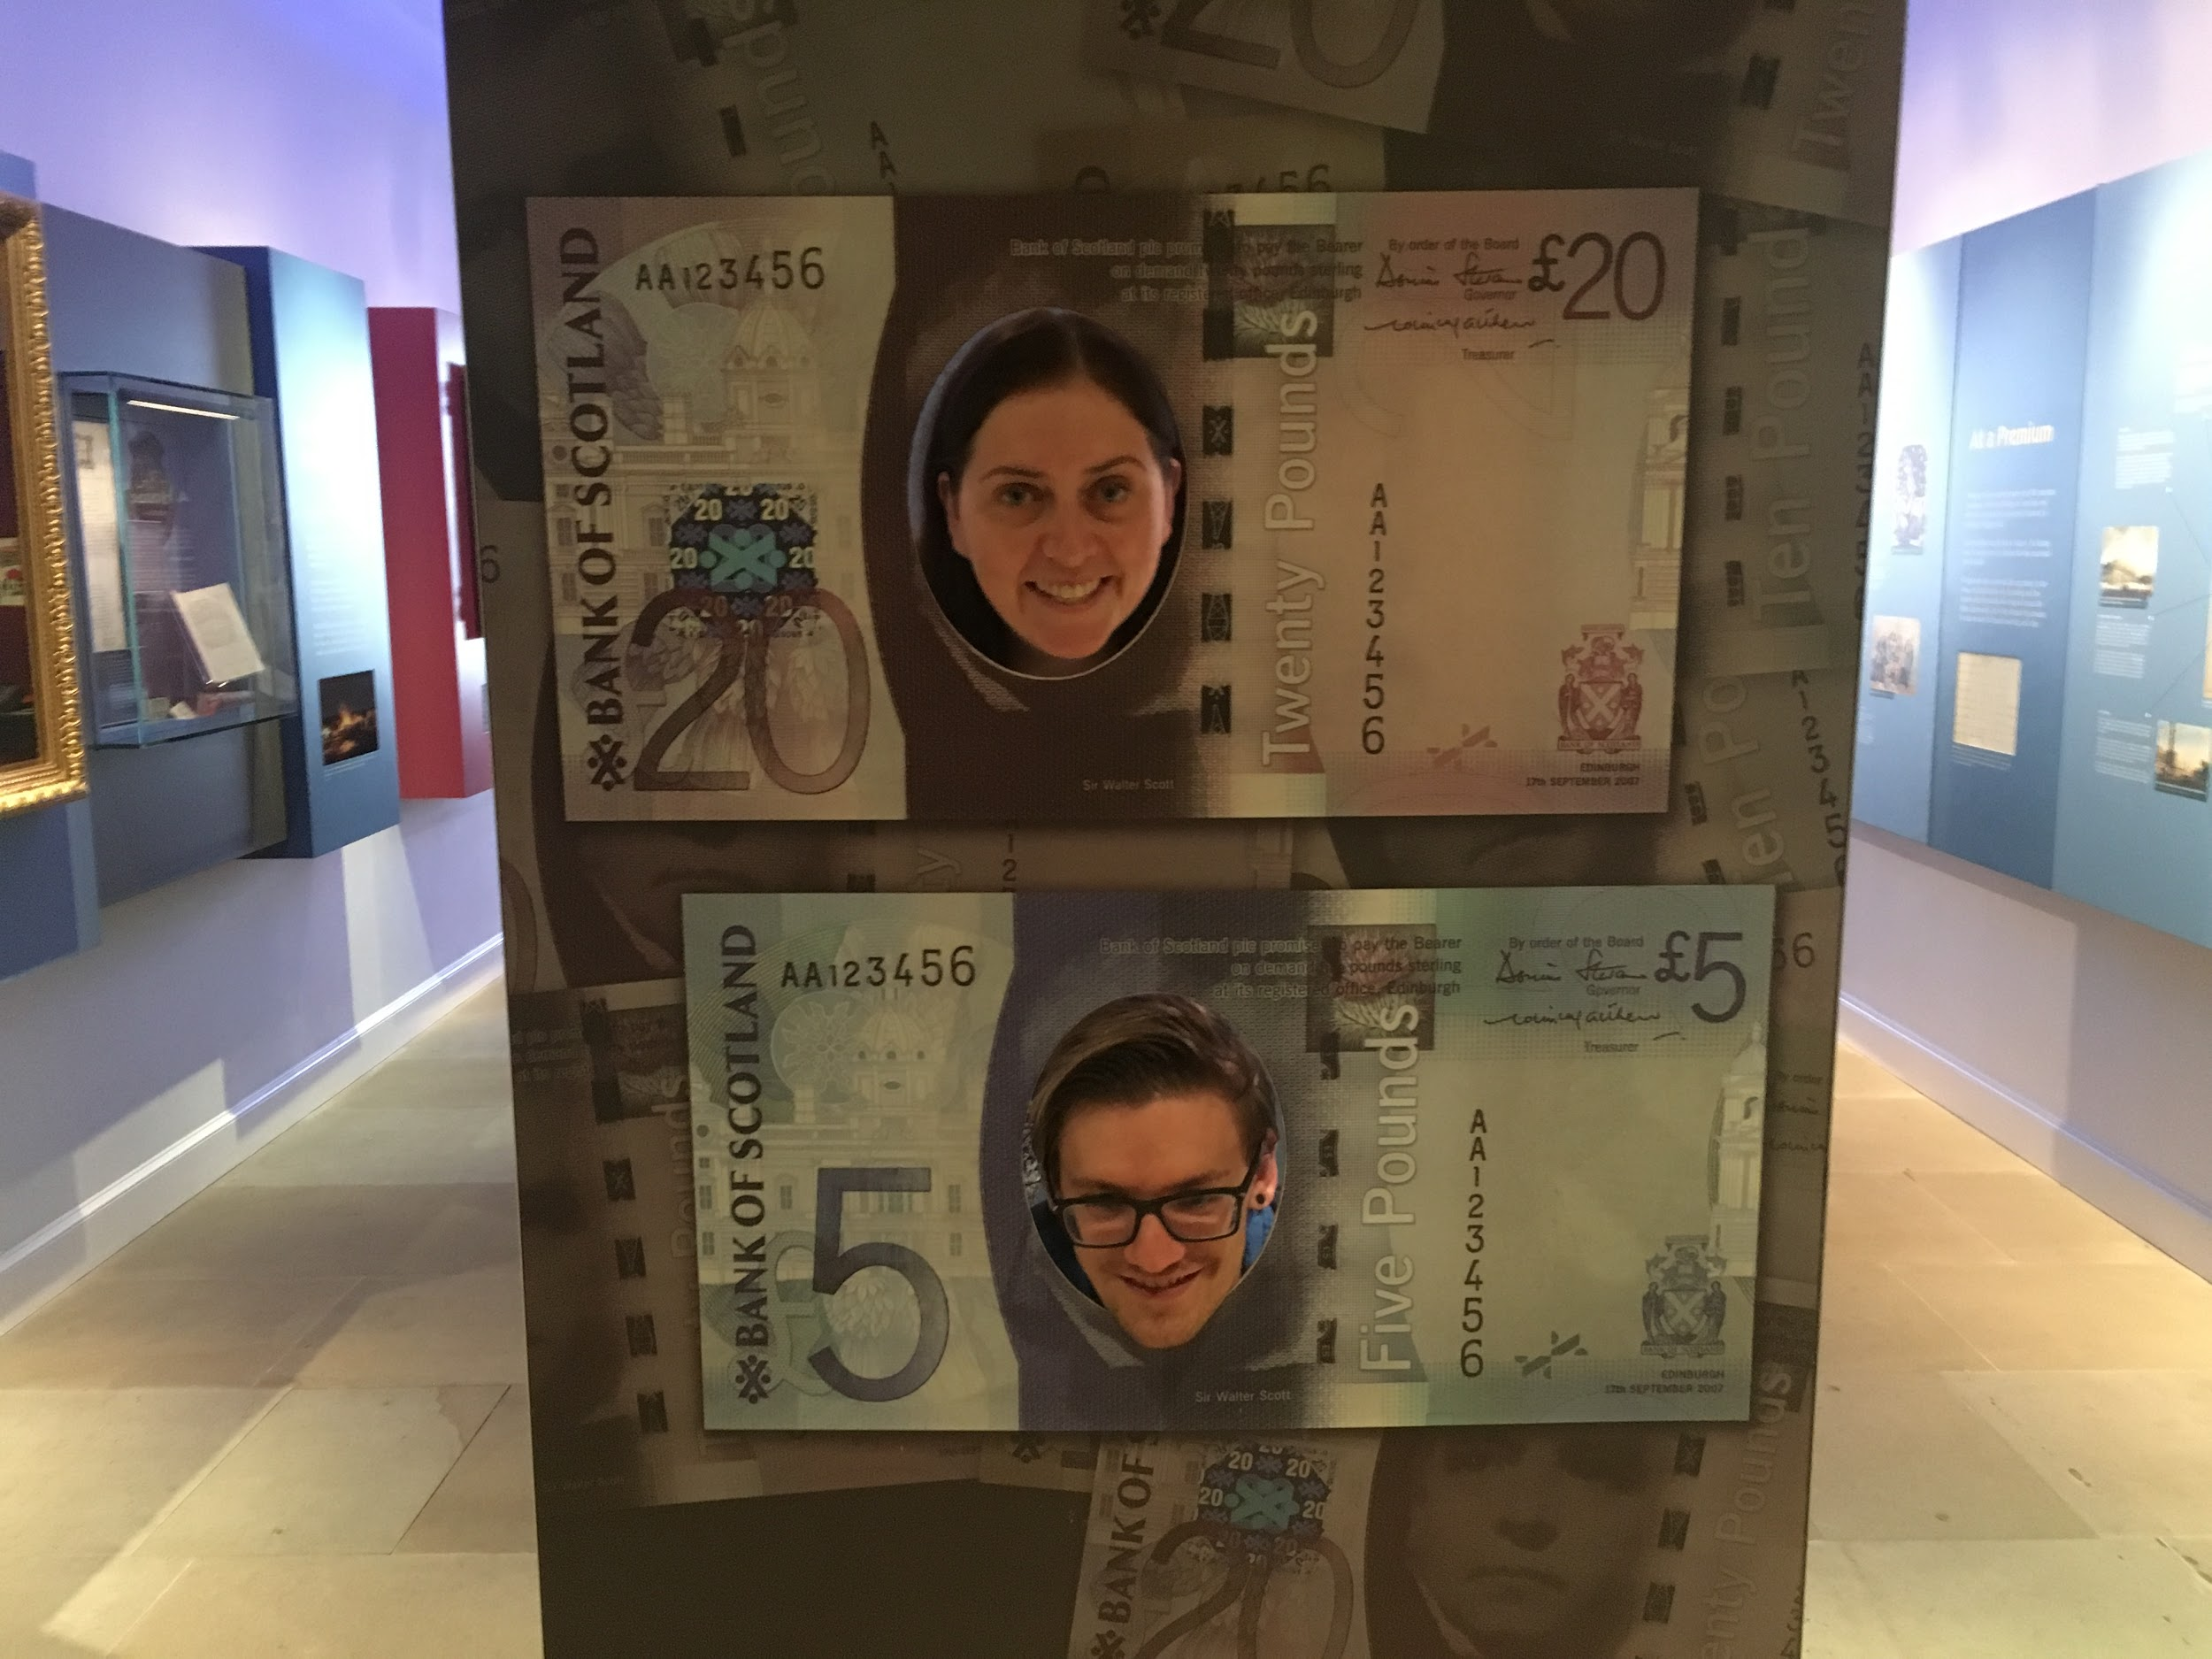
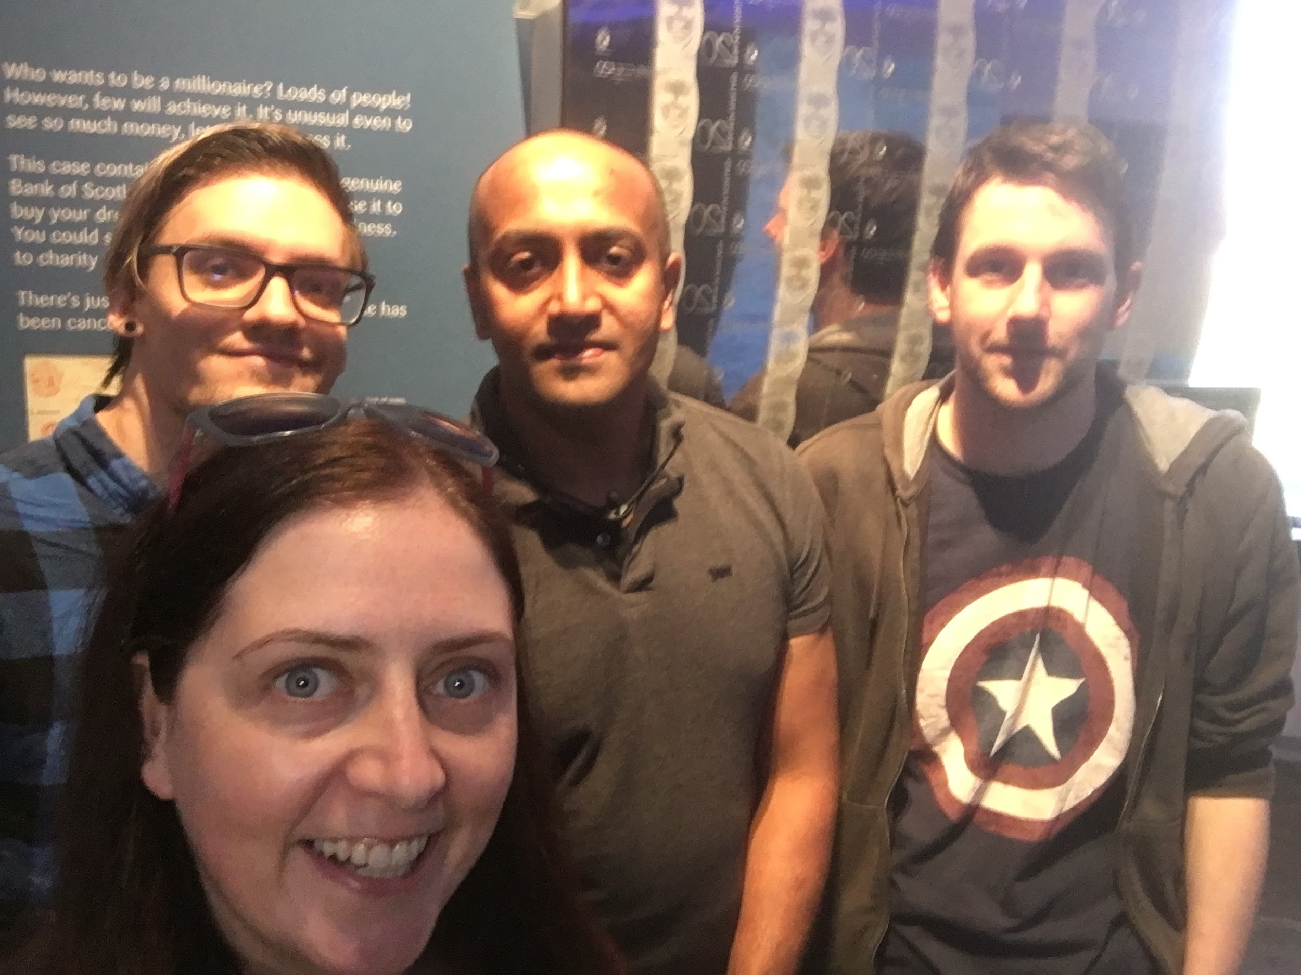
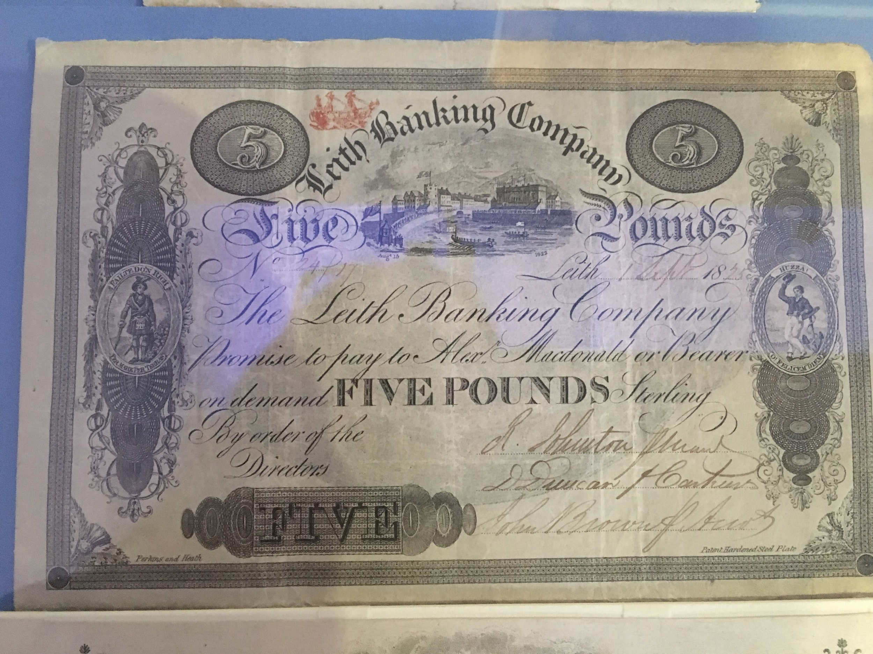
Planning -Field Trip!!

Slide 6
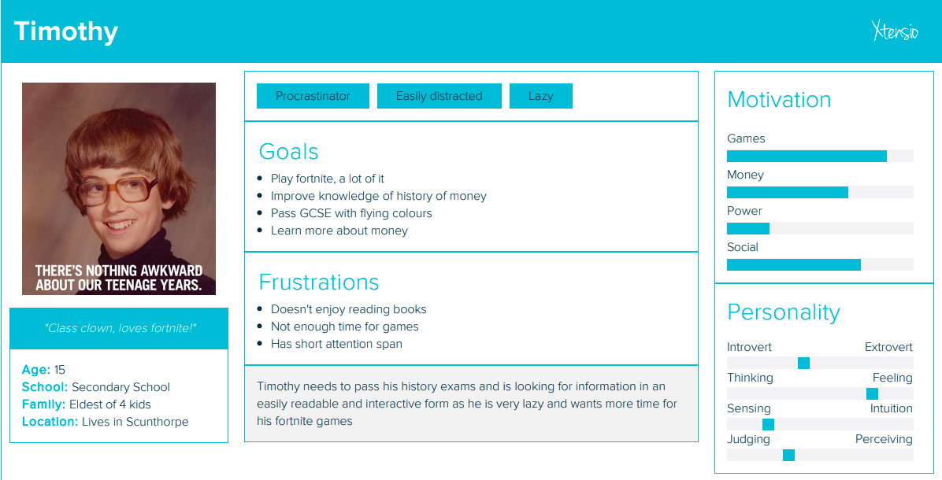
Planning

Slide 7
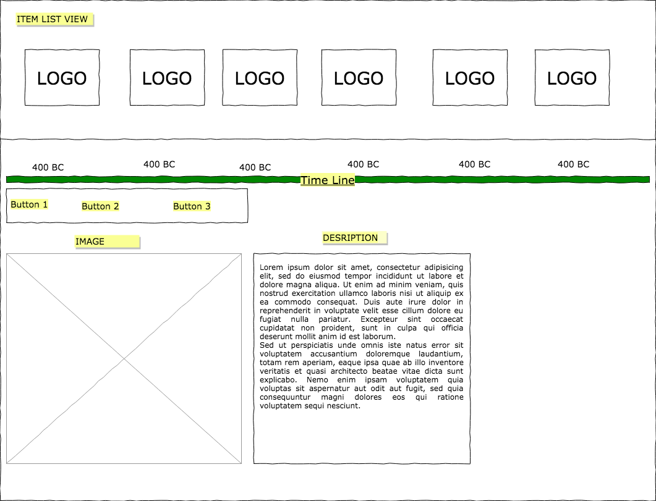
Planning -Wireframe

Slide 8

The solution
An interactive scrollable timeline, with additional information, maps and charts.

Slide 9
The solution
Let’s take a look at the app in action...

Slide 10

HighCharts & Gold Price API:
Gold tracker

Slide 11
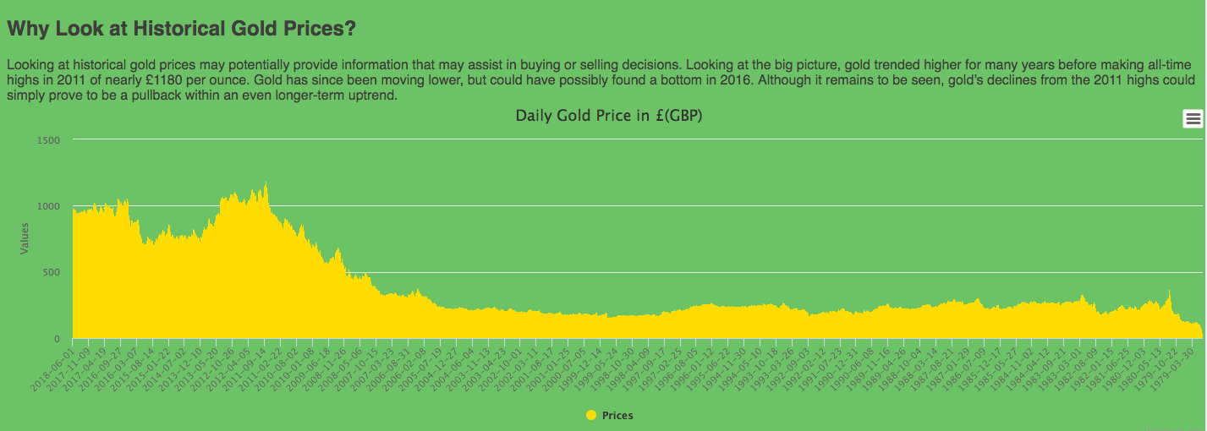
Why Look at Historical Gold Prices?

Slide 12
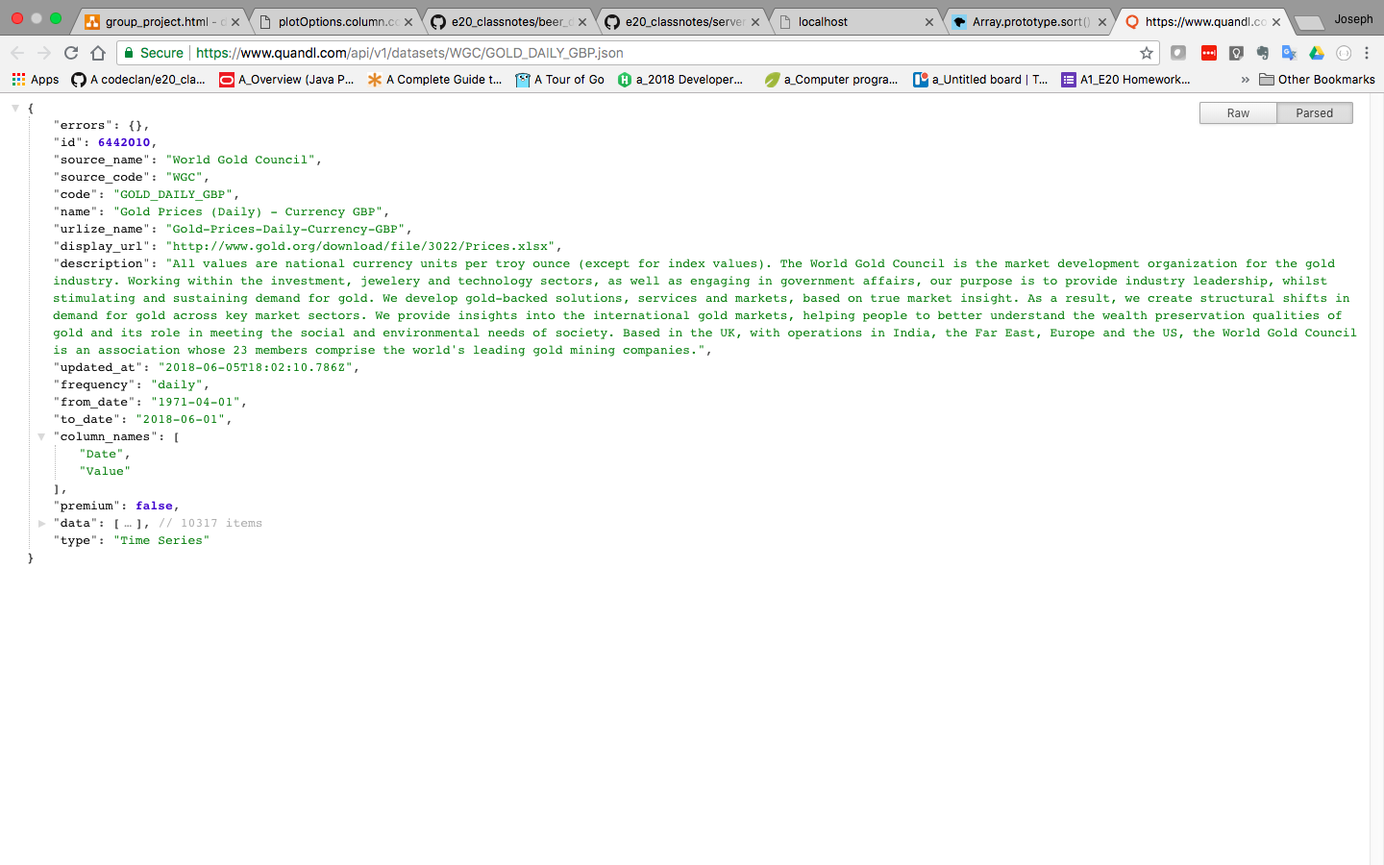
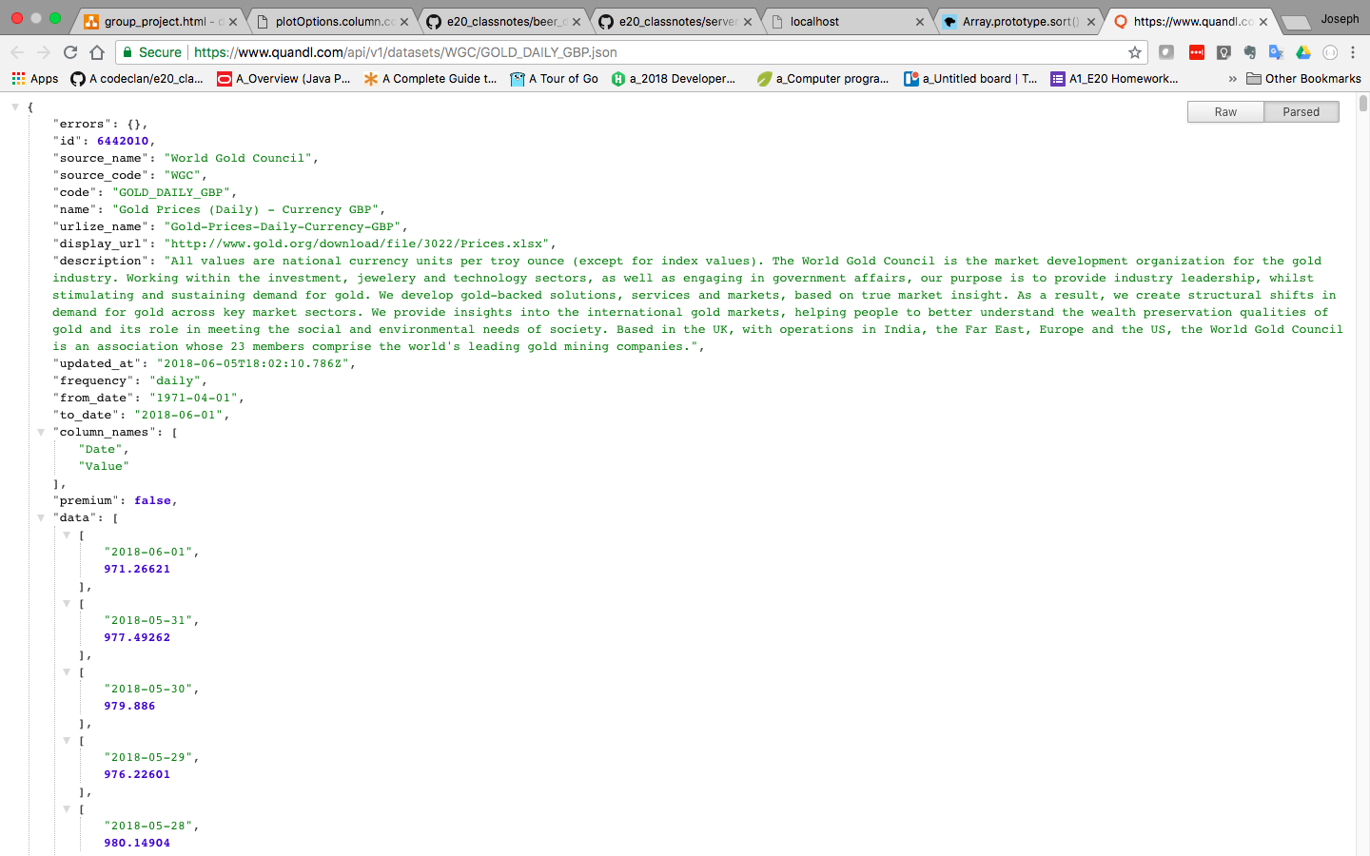
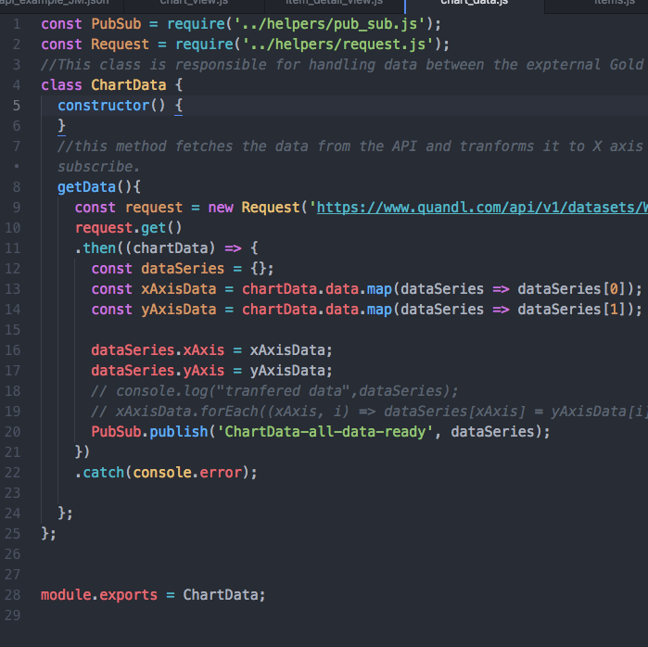
The Coding Journey … The API… (conundrum)

Slide 13
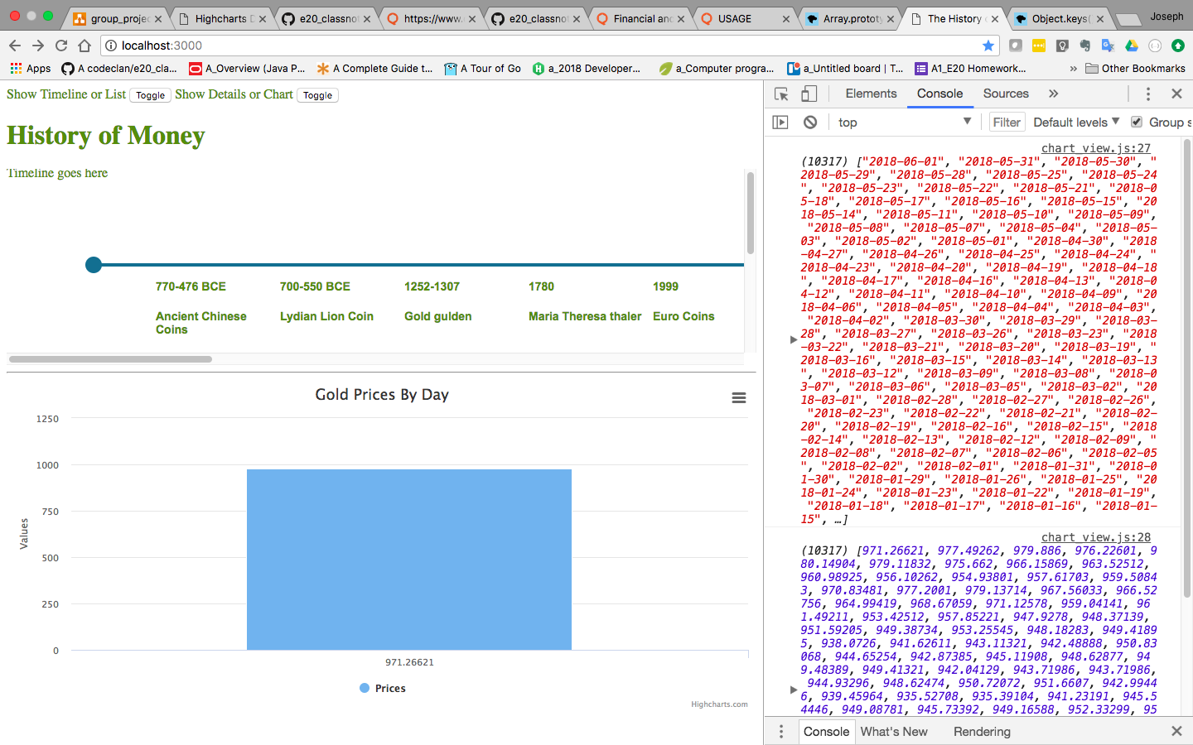
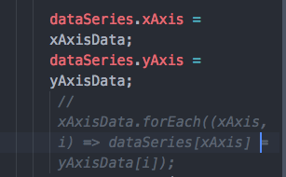
The Coding Journey … The API… (conundrum)
What???? (Sian)

Slide 14
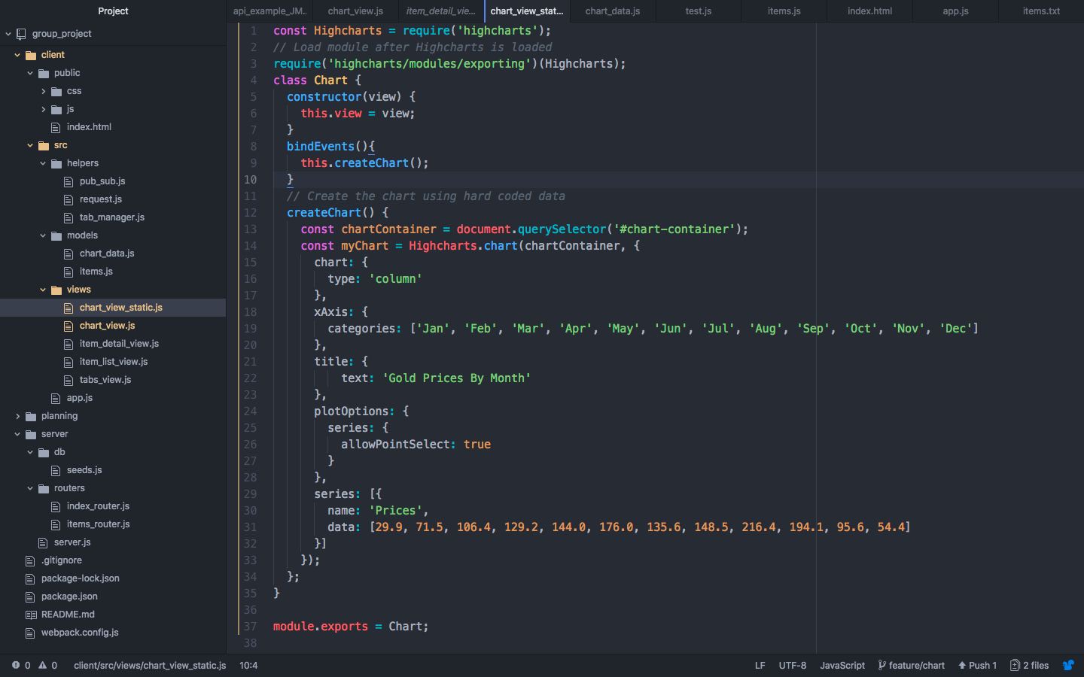
The Coding Journey … The Libraries: HighCharts
Why HighCharts?
Highcharts was released in 2009. Highcharts is a charting library written in pure JavaScript, offering an easy way of adding interactive charts to your web site or web application

Slide 15
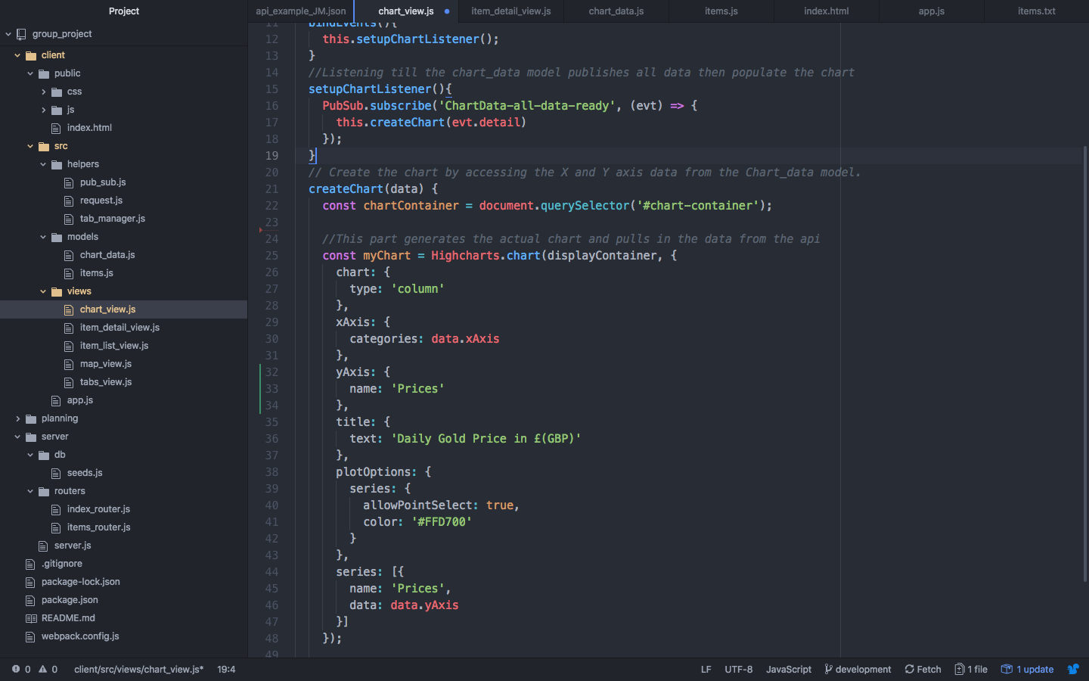
The Coding Journey … The Libraries: HighCharts: Dynamic with API data...
Modular approach:
One Model and one View file, requiring the HighCharts library

Slide 16
Leaflet:
Mapping

Slide 17

Leafletjs maps
First Attempt
Leaflet is an open-source JavaScript library for mobile-friendly interactive maps, it provides all standard map functionality such as zooming in/out, placing markers, circles, polygons etc.

Slide 18
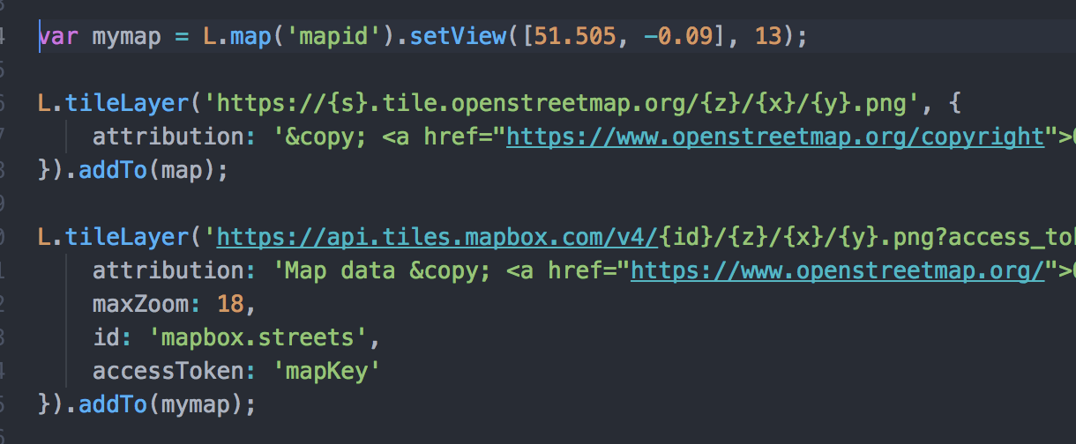
What didn’t work and how I fixed it
Attempting to get the mapbox tile layers to display on the map →
Turned out to be simpler to use the provided open street maps tile layer -->

Slide 19
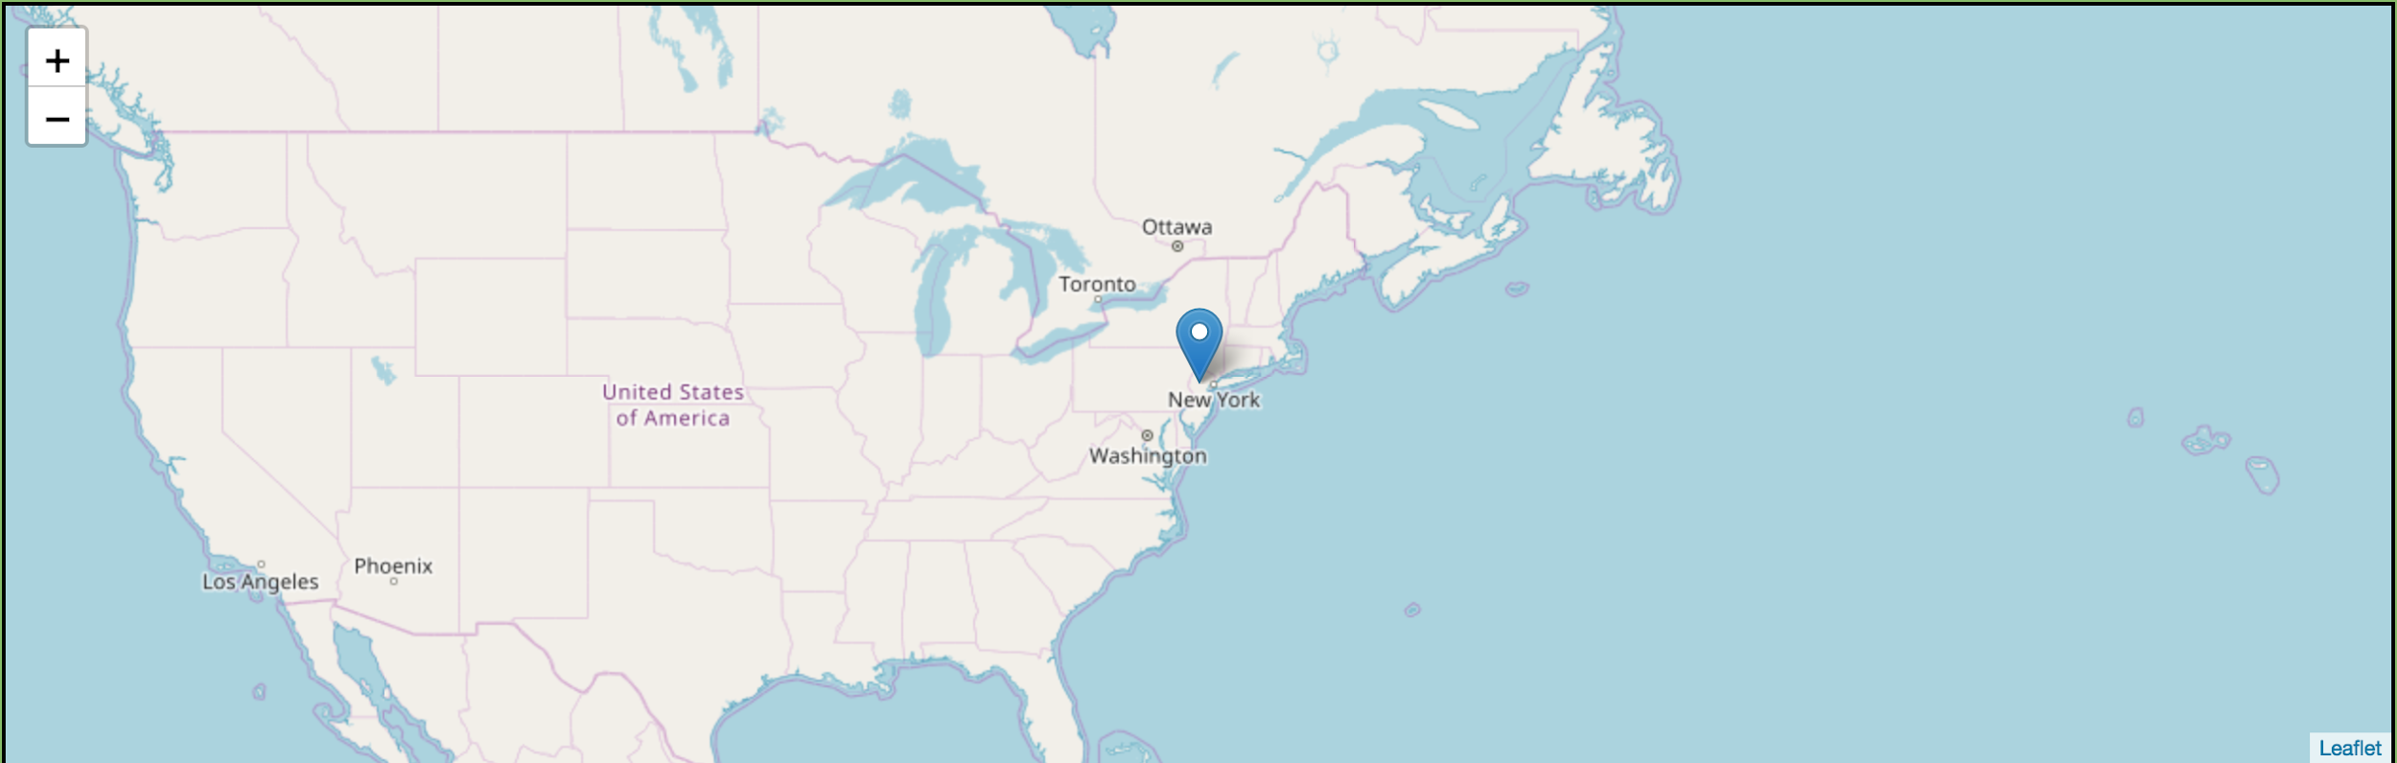
The result
Map renders at the correct point and places the marker

Slide 20
Timeline

Slide 21
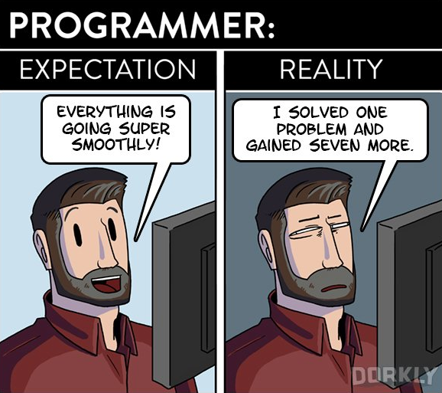
Expectation Vs Reality

Slide 22

How did we do it?
Time to review the code

Slide 23
What I learned
My least favourite part
My favourite part

Slide 24
Any questions?

